Slide 1
Describing Pictures

Slide 2
The things that we can describe
Photo
Poster
Drawing
Advertisement
Traffic sign

Slide 3
General Topic
The picture tells you …
We have some pictures, all related to …
The pictures are about …
In this picture, I can see …
The photo was taken by …

Slide 4
Telling the location
In the foreground/background you can see ...
In the foreground/background there is ...
In the middle/centre there are ...
At the top/At the bottom there is ...
On the left/right there are ...
Behind/In front of ... you can see ...
Between ... there is ...

Slide 5
Telling that you can see
I can see a girl with pink dress and buckle hat.
I can see crocodile watching the zebra.
I can see their happiness because of their togetherness.
I can see some people smiling cheerfully.

Slide 6
Describing people
She is quite ….
He looks like ….
He is about … (age, height)
She seems …

Slide 7
Guessing the picture
When you don’t know about the picture exactly, you can use modal of verbs (could, may, might) ;
She could go to movie.
He may take a nap on the bus.
They might be waiting for the concert.

Slide 8
Facts and opinions
Everybody knows that …
People believe that …
In my opinion …
I think …
It seems …

Slide 9
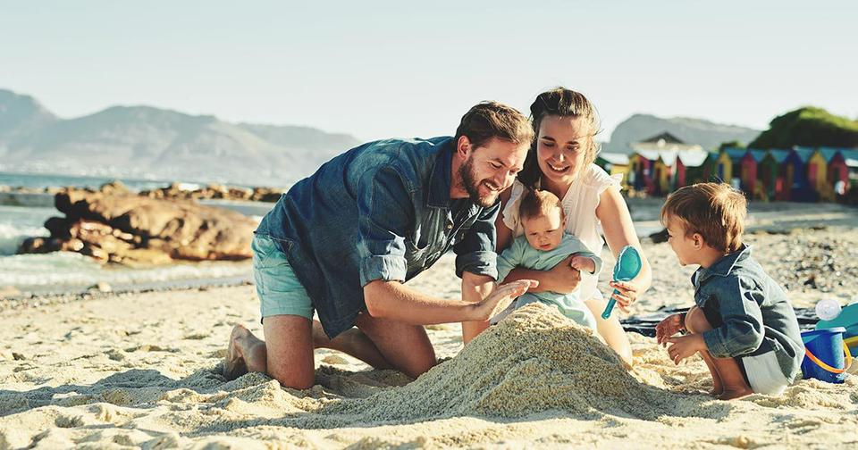
Example
Description:
It seems that they are having family vacation. They go to the beach. Mom n dad accompany their children playing sand. They look very happy.

Slide 10


Describe those picture: who and where they are, what they are doing, what the situation is.

Slide 11


Describe those pictures!

